Slide 1

Set Operators

Slide 2

Agenda
Set Operators: Types and guidelines
UNION and UNION ALL operator
INTERSECT operator
MINUS or EXCEPT operator
ORDER BY clause in set operations

Slide 3
Set Operators

Slide 4
Set Operators: Diagrammatic Representation
UNION/UNION ALL
INTERSECT
MINUS

Slide 5
Set Operators: Explained
Operator | Returns
UNION | Combine two or more result sets into a single set, without duplicates.
UNION ALL | Combine two or more result sets into a single set, including all duplicates.
INTERSECT | Takes the data from both result sets which are in common.
EXCEPT | Takes the data from first result set, but not the second (i.e. no matching to each other)

Slide 6
Set operators: Syntax
To demonstrate set operators in SQL, let’s create the below tables and populate it with data.
CREATE TABLE hr.dbo.fruits_1 (FruitName VARCHAR(100));
INSERT INTO hr.dbo.fruits_1 VALUES ('Apple'),('Orange'),('Strawberry'),('Lemon'),('Avocado')
CREATE TABLE hr.dbo.fruits_2 (FruitName VARCHAR(100));
INSERT INTO hr.dbo.fruits_2 VALUES ('Lemon'),('Avocado'),('Grapefruit'),('Apricot’);

Slide 7
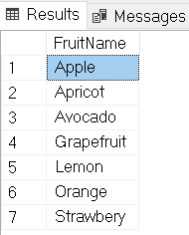
UNION Operator
The UNION operator returns rows from both tables after eliminating the duplicates.
SELECT * FROM hr.dbo.fruits_1
UNION
SELECT * FROM hr.dbo.fruits_2;

Slide 8
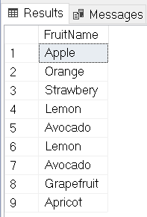
UNION ALL Operator
The UNION ALL operator returns rows from both tables, including all duplicates.
SELECT * FROM hr.dbo.fruits_1
UNION ALL
SELECT * FROM hr.dbo.fruits_2;

Slide 9
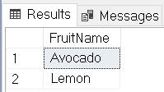
INTERSECT Operator
The INTERSECT operator returns rows that are common to both tables.
SELECT * FROM hr.dbo.fruits_1
INTERSECT
SELECT * FROM hr.dbo.fruits_2;

Slide 10
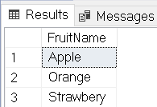
MINUS or EXCEPT Operator
The MINUS/EXCEPT operator returns all the distinct rows selected by the first query, but not present in the second query result set.
SELECT * FROM hr.dbo.fruits_1
EXCEPT
SELECT * FROM hr.dbo.fruits_2;

Slide 11
Using ORDER BY clause in set operations
The ORDER BY clause can appear only once at the end of the compound query
Component queries cannot have individual ORDER BY clauses
The ORDER BY clause recognizes only the columns of the first SELECT query
By default, the first column of the first SELECT query is used to sort the output in an ascending order.

Slide 12
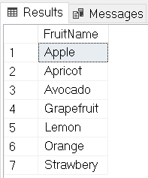
Using ORDER BY clause in set operations
SELECT * FROM hr.dbo.fruits_1
UNION
SELECT * FROM hr.dbo.fruits_2
ORDER BY FruitName;

Slide 13

Summary
UNION and UNION ALL operator
INTERSECT operator
MINUS or EXCEPT operator
Using the ORDER BY clause in set operations

Slide 14
THANKS!
Any questions?

